Slide 1
Cinemunchies
Team Urkel
May 2018
Notes:
Kimberly

Slide 2
Contents
Team Urkel
What’s Been Missing
Description of project
Project structure
Project selection process
Our approach
Tools and technologies
Features and functions
Our challenges
Our successes
What we learned
Next Steps
Questions & answers

Slide 3

Team Urkel
Kalsang Bhutia
Robyn Craig
Zac Keilholz
Kimberly Maturo-Hilt

Slide 4

Mission & Value
Mission:
Design a collaborative space that links love of the cinema and the love of munchies together for an ahhhh, ohhhhh or WOW experience.
Value:
We aim to deliver creativity and ease to our solutions as well as our love and passion for food and movies to our customer experience.

Slide 5

What’s Been Missing
It’s simple, ever watch a movie?
Ever think to yourself, what are they eating?
It looks SO GOOD.
I WANT THAT TOO!
Answered YES to both the above … then CINEMUNCHIES is what you need.
Notes:
Robyn

Slide 6
Description of Project
We bring the munchies of the movies to you.
Search a movie
See a list of munchies
Select a munchie
Get the recipe
OR
Don’t see the munchie yet, then add to our ever expanding database!
Want to know what movie to pair with a munchie, we got you covered for that too! (future functionality)
Notes:
Robyn

Slide 7
Project Team Structure
- Overall technical responsible
- Solution design advisory
- Firebase
Solution Architect & Back-end Development
- Jquery
-Javascript
- AJAX
-API calls
- Bootstrap
- Matrialize
- HTML
- CSS
- Visual design, imagery, graphics
Front End Development
- Overall project management
- Jira administrator
-UX testing and issue identification
- wireframing
Project Manager
UX Tester
Zac
Kalsang
Robyn
Kimberly
Front-end & Back-end Development
Notes:
Kalsang

Slide 8
Project Selection Process
ALL IDEAS
SeeFood
Find a Dog Park
Where to Meet
TOP IDEAS
Where to meet
SeeFood
FINAL IDEA
CineMunchies*
All team members submitted ideas
37 ideas in total
Each team member picked their Top-5
Each idea which received a rating was presented, discussed, challenged and brain-stormed the experience
Narrowed down top choices
Another team was already working on the Where to Meet
All agreed to move forward with SeeFood
New name established upon discussion and input from Jesse for project approval
Name provided by Jesse Mortenson
Notes:
Kalsang

Slide 9
Product Demonstration
https://zackeilholz.github.io/CineMunchies/
Notes:
Kimberly

Slide 10
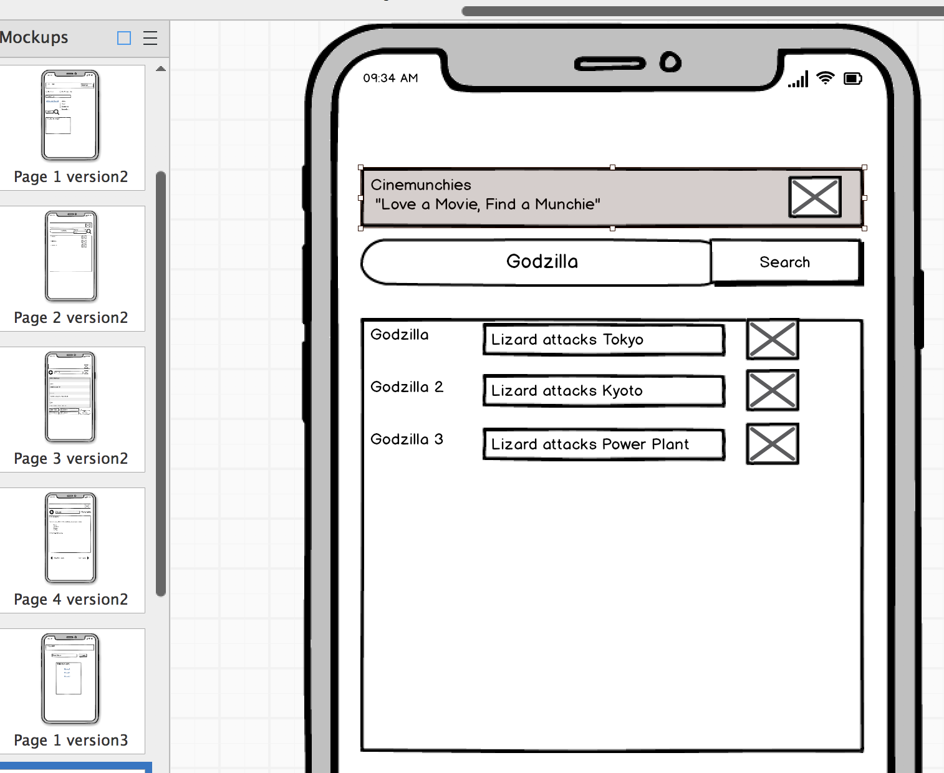
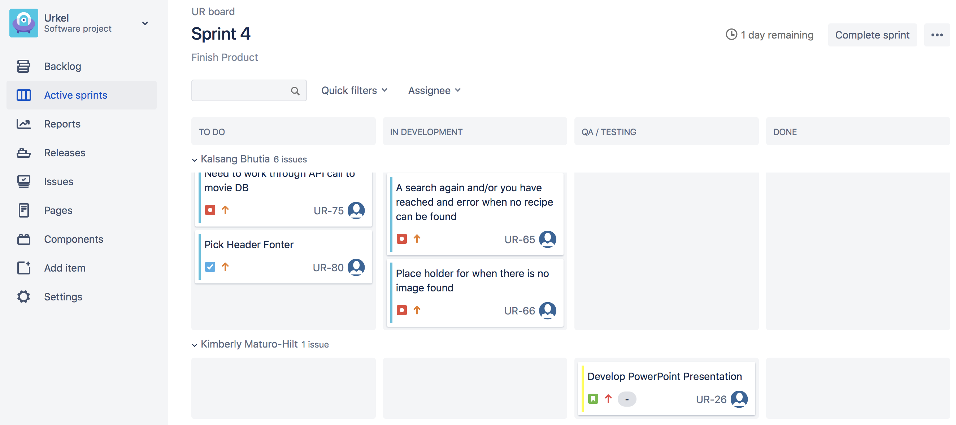
Technologies and Approach
Wireframing
Balsamiq
Project Management
Jira
Notes:
Kalsang

Slide 11
Technologies and Approach
BackEnd
Firebase
Image of our Firebase DB Here
Front End
Materialize
Materialize Logo or Code Here
Notes:
Kalsang

Slide 12
Our Challenges
Branching & Merging
work with TA
communication
A single Page format
testing, testing, testing
clearly documenting the experience
trial and error
Creative Differences
Discuss
COMPROMISE
Notes:
Kalsang

Slide 13
Our Successes
Mobility
Functionality
Design
Team work
Positive attitudes
Willingness to listen
Adaptability
Helpfulness
Wanted a mobile solution; kept to the delivering a mobile friend solution
2 API calls
Firebase database
Clean
Crisp
Simple
Notes:
Zac

Slide 14
What We Learned
Accept CHANGE in Course
Test and then test again
Communicate, there is never enough talking
Prioritize the deliverable
Notes:
Consider talking about:
Constraints vs Objectives

Slide 15
Next Steps
Notes:
Zac

Slide 16

Questions & Answers

